Slide 1

What’s Up with the R Consortium?
Joseph Rickert
Microsoft & R Consortium ISC

Slide 2

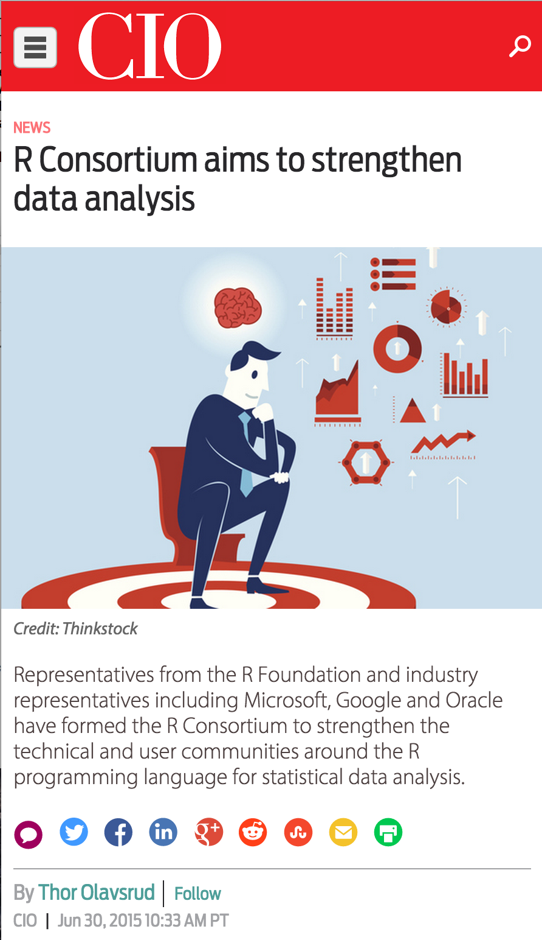














A non-profit trade organization supporting the R Community.

Slide 3
Goals
Create infrastructure and standards to benefit all R users
Promote R as a vital component of production data science platforms
Create and promote best practices for:
the development and maintenance of R code and applications
evaluating, adopting, validating, and managing R code and applications
Provide information and metrics about growth and adoption of R
Support the annual useR! conference

Slide 4
Board of Directors
David Smith – Microsoft
Dinesh Nimal – IBM
Hadley Wickham – ISC Representative
JJ Allaire - RStudio
John Chambers – R Foundation
Louis Bajuk-Yorgan (chair) – TIBCO
Richard Pugh – Mango Solutions

Slide 5
Infrastructure Steering Committee (ISC)
Mission: create, organize, establish and maintain
Infrastructure projects
Infrastructure collaboration Initiatives
Current members
Dirk Eddelbuettel – Ketchum Trading
Frederick Reiss - IBM
Hadley Wickham (chair) – RStudio
Joseph Rickert – Microsoft
Luke Tierney – University of Iowa
Stephen Kaluzny – TIBCO

Slide 6
Projects Funded

Slide 7
R-HUB: $80K
Gábor Csárdi
A service for developing, building, testing and validating R packages
Simplify the R package development process:
Complement CRAN and R-Forge
https://github.com/r-hub/proposal

Slide 8
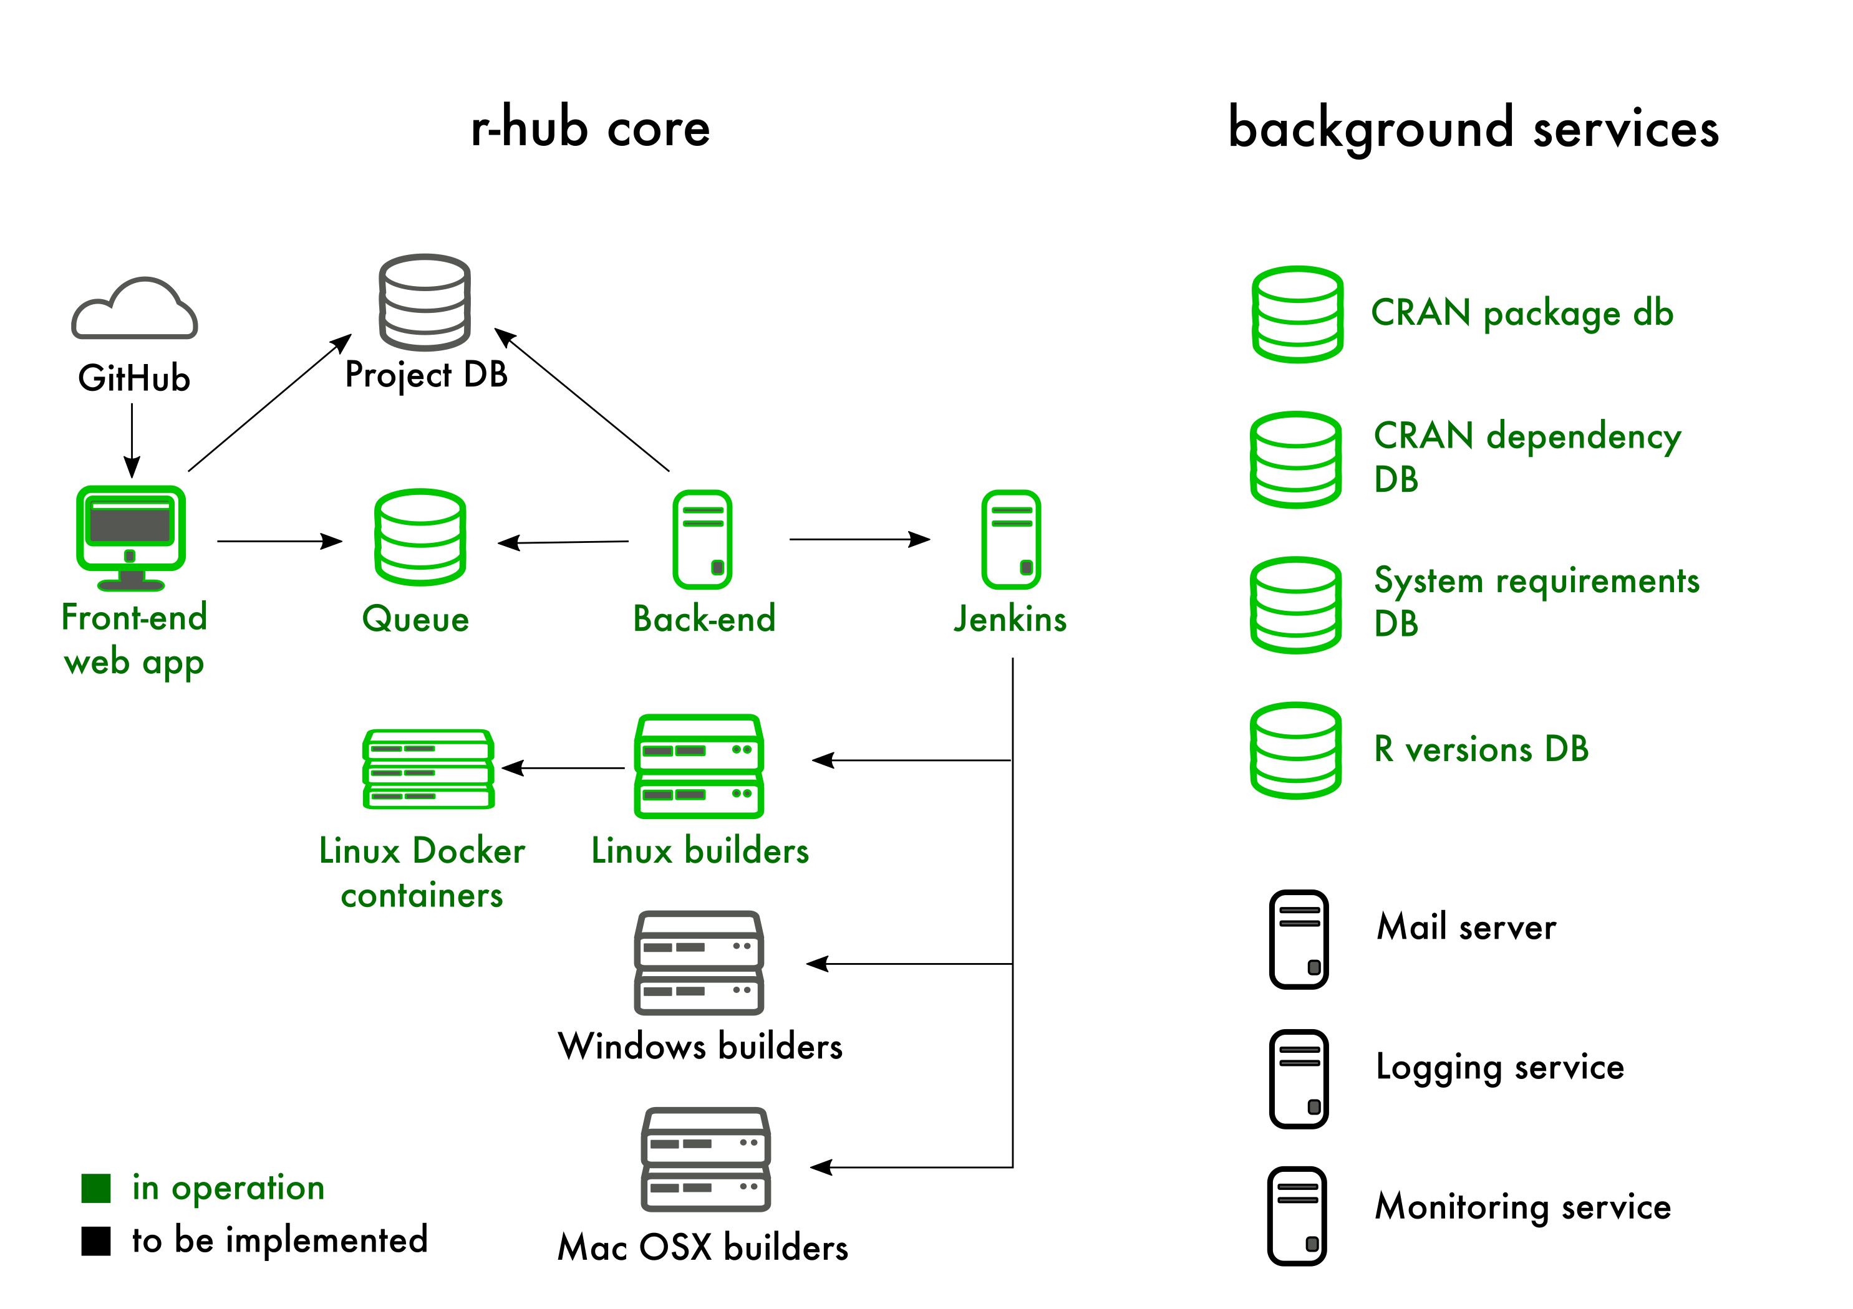

Slide 9
Improving Database Interface (DBI): $25K
Kirill Müller (ETH Zürich)
Improve database access in R so that porting code is simplified and less prone to error
Plan:
Create a DBI specification, centralized test and boiler plate for DBI backends
Improve existing DBI backends to adhere to the standard
Focus on RMySQL, RPostgres and RSQLite
https://github.com/rstats-db/DBItest

Slide 10
RIOT 2016 Workshop 2016: $10K
Mark Hornick, Lukas Stadler and Adam Welc (Oracle)
RIOT: R Implementation, Optimization and Tooling
A one-day workshop – July 3 at Stanford:
Unite R language developers
Identify R language development and tooling opportunities
Increase involvement of the R user community
http://riotworkshop.github.io/

Slide 11
R Localization Proposal (RL10N): $10K
Richie Cotton (Weill Cornell Medicine in Quatar) and Thomas Leeper (The London School of Economics)
Majority of R packages in English only
RL10N project will make it easier for R developers to include translations in their own packages
Plan:
Improve msgtools package
New package to adapt MTurkR for managing translation
New package to adapt translateR for automated translations

Slide 12

SatRdays: $10K
Gergely Daroczi (Hungarian R user group) and Steph Locke (Mango Solutions)
“SatRdays” are community-led, regional conferences
3 conferences planned
Budapest, Hungary – September 3, 2016
San Juan, Puerto Rico
Cape Town, South Africa
http://planning.satrdays.org/
Gergely to speak: Thursday 1:40pm!!

Slide 13
Software Carpentry R Instructor Training: $10K
John Blishak, Jonah Duckles, Laurent Gatto, David LeBauer, and Greg Wilson (Software Carpentry)
Two-day in-person instructor training course
Focused on teaching R programming
Introduces the basics of educational psychology and instructional design
Targeted towards teaching adult learners
http://software-carpentry.org/blog/2016/03/r-consortium-training.html

Slide 14
Simple Features Access for R: $10K
Edzer Pebesma (Institute for Geoinformatics, University of Muenster)
Simplify analysis of geospatial data
R package that complies with the “Simple Features” standard for access and manipulation of spatial vector data
Open Geospatial Consortium
International Organization for Standardization
Write a C++ interface to GDAL 2.0
http://r-spatial.org/r/2016/02/15/simple-features-for-r.html

Slide 15
Working Groups
Collabotaion
Consensus
Confidence

Slide 16
ISC Working Groups
Benefits:
Sponsored by the R Consortium
Receive attention from the R Foundation
Visible to the greater R Community
Receive administrative support from the R Consortium
What they are:
Projects for exploring new technology
Forums for achieving consensus
The mechanism for organizing and executing large collaborative projects

Slide 17
A Unified Framework for Distributed Computing in R: $10K Distributed Computing Working Group
Develop a common framework to simplify & standardize how users program distributed applications in R
Status:
ddR is a CRAN package
Focus:
More algorithms
Spark driver
Distribute Computing Working Group Webpage
Ed Ma speaking Tuesday 11:24am!!
Working Group Members
Bernd Bischl, Technical University, Munich
Matt Dowle, H2O
Mario Inchiosa, Microsoft
Michael Kane, Yale University
Javier Luraschi, RStudio
Edward Ma, HP
Indrajit Roy, HP
Luke Tierney, University of Iowa
Simon Urbanek, R Core and AT&T
Joseph Rickert , Microsoft -ISC sponsor)

Slide 18
Future-proof native APIs for R
Working Group Members
Alexander Bertram, BeDataDriven
Torsten Hothorn, University of Zurich
Mick Jordan, Oracle Labs
Michael Lawrence, Genentech
Karl Millar, Google
Duncan Murdoch, University of Western Ontario
Radford Neal, University of Toronto
Edzer Pebesma, University of Münster
Indrajit Roy, HP Labs
Michael Sannella, TIBCO
Lukas Stadler, Oracle Labs
Luke Tierney, University of Iowa
Simon Urbanek, AT&T Research Labs
Jan Vitek, Northeastern University
Gregory Warnes, Boehringer Ingelheim
Stephen Kaluzny - ISC Sponsor
Assess R’s current native API
Gather community & R core input
Seek consensus
New API
Easy-to-understand consistent
Verifiable
Able to drive R language adoption
https://wiki.r-consortium.org/view/R_Native_API

Slide 19
Code Coverage Tool for R
Working Group Members
Shivank Agrawal, Oracle
Chris Campbell, Mango Solutions
Santosh Chaudhari, Oracle
Karl Forner, Quartz Bio
Jim Hester, RStudio
Mark Hornick, Oracle – Group Leader
Chen Liang, Oracle
Willem Ligtenberg, Open Analytics
Andy Nicholls, Mango Solutions
Vlad Sharanhovich, Oracle
Tobias Verbeke, Open Analytics
Qin Wang, Oracle
Hadley Wickham, RStudio – ISC Sponsor
Develop a tool for R that determines code coverage upon execution of a test suite
Improve software quality
Promoting the use of code coverage more systematically within the R ecosystem
https://wiki.r-consortium.org/view/Code_Coverage_Tool_for_R

Slide 20
What’s Next? Call for proposals closes July 10th

Slide 21
Tips for getting your proposal funded:
Think big: something that will benefit a sizeable portion of the R Community for years to come
Collaborate: seek expert opinion about your ideas and find potential collaborators
Do your homework: make sure you understand what relevant work already exists
Estimate: work, resources and money required

Slide 22
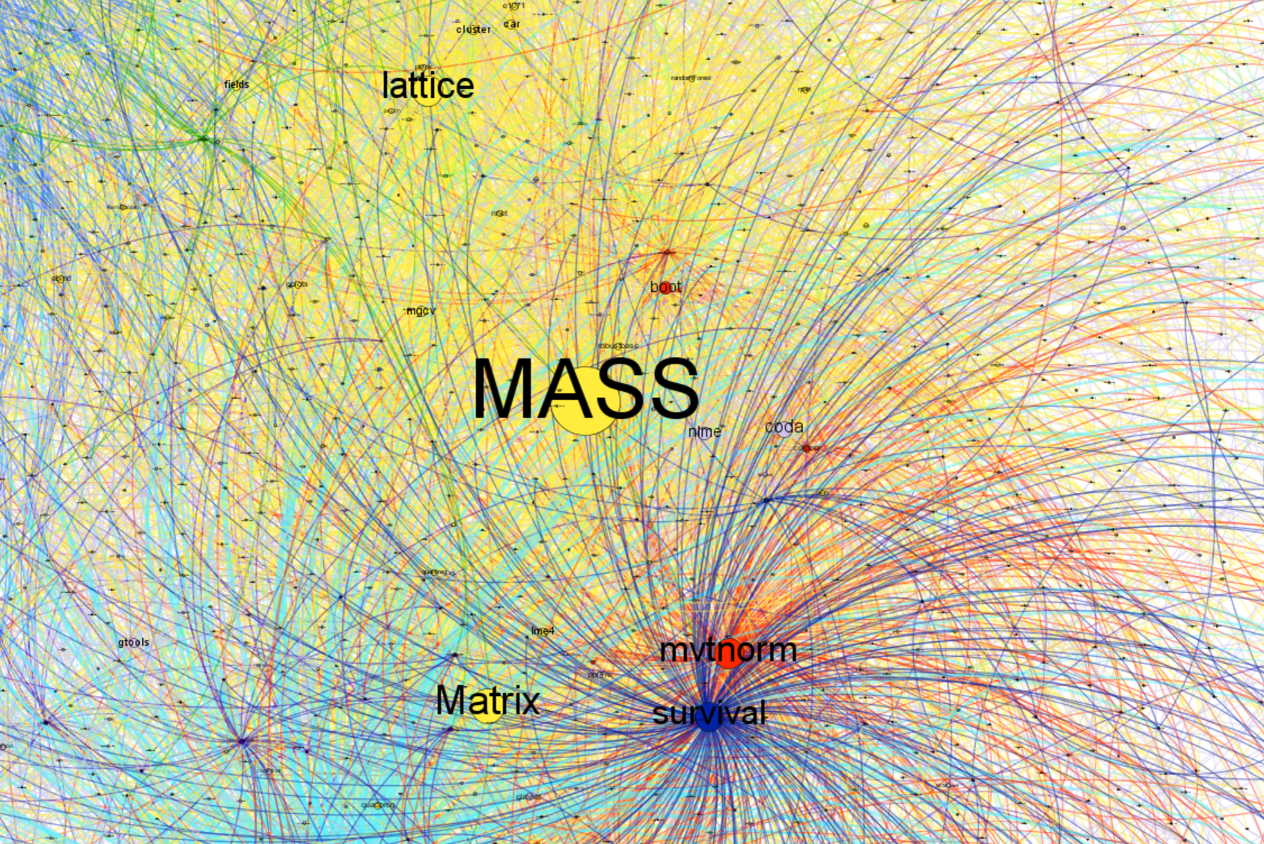
Project Areas?
Infrastructure
Education
Documentation
Production use of R
Package ecosystem
Characterize / Forecast
Package recommendation
Package discovery tool

Slide 23
Get Involved!!
Join / Support an existing project
Submit a proposal
Call for proposals now open, closing July 10th 2016
https://www.r-consortium.org/projects/call-proposals
Review the project archives
http://lists.r-consortium.org/pipermail/rconsortium-projects/
Join the mailing lists
http://lists.r-consortium.org/mailman/listinfo/rconsortium-projects
Convince your employer to join the R Consortium

Slide 24
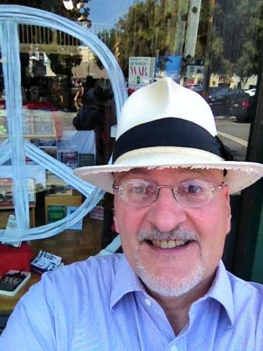
Thank You
jrickert@Microsoft.com
@RevoJoe

